Slide 1
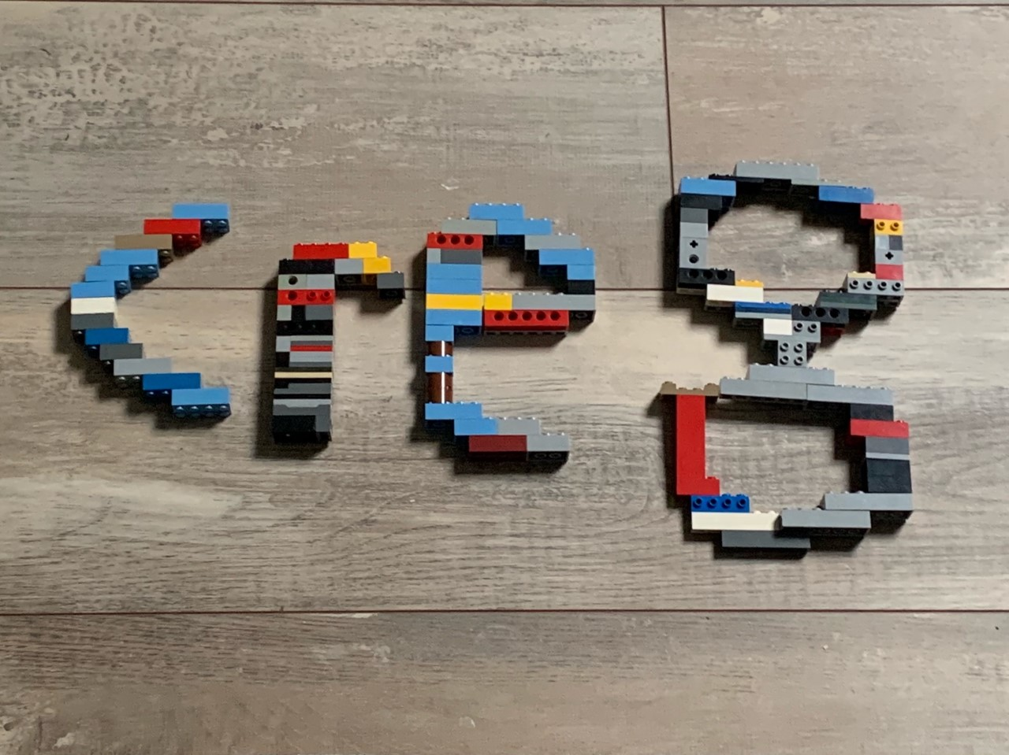
CREATE CHALLENGE

Slide 9
