Slide 1
SLIP CHALLENGE
Shapes, Lines & Interesting Patterns
St Anne’s NS

Slide 2
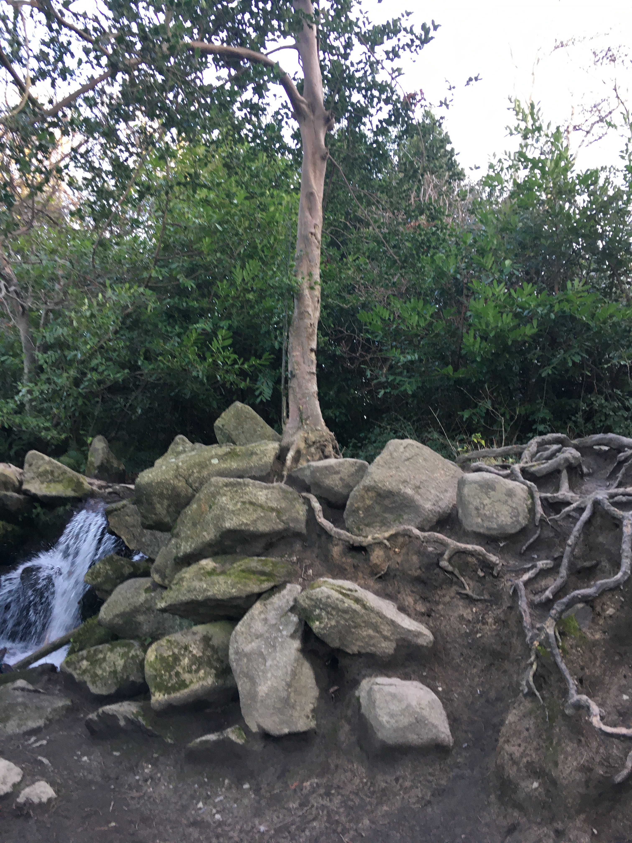

Slide 5
